Slide 1
MCU TNC Deliverable 3
David Cain, Kobe Keopraseuth, and Kaleb Leon

Slide 2
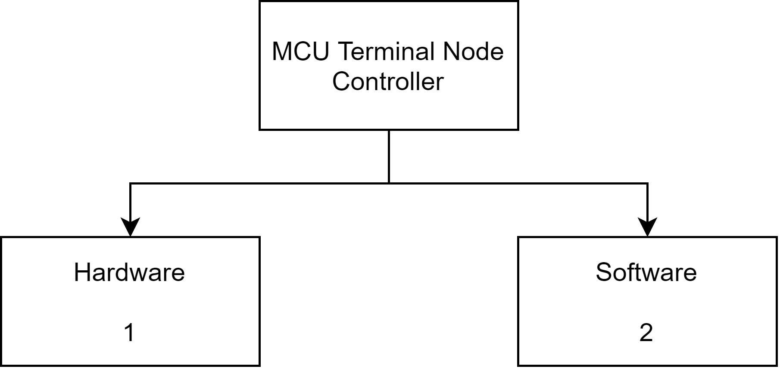
Testing Tree at High Level

Slide 3
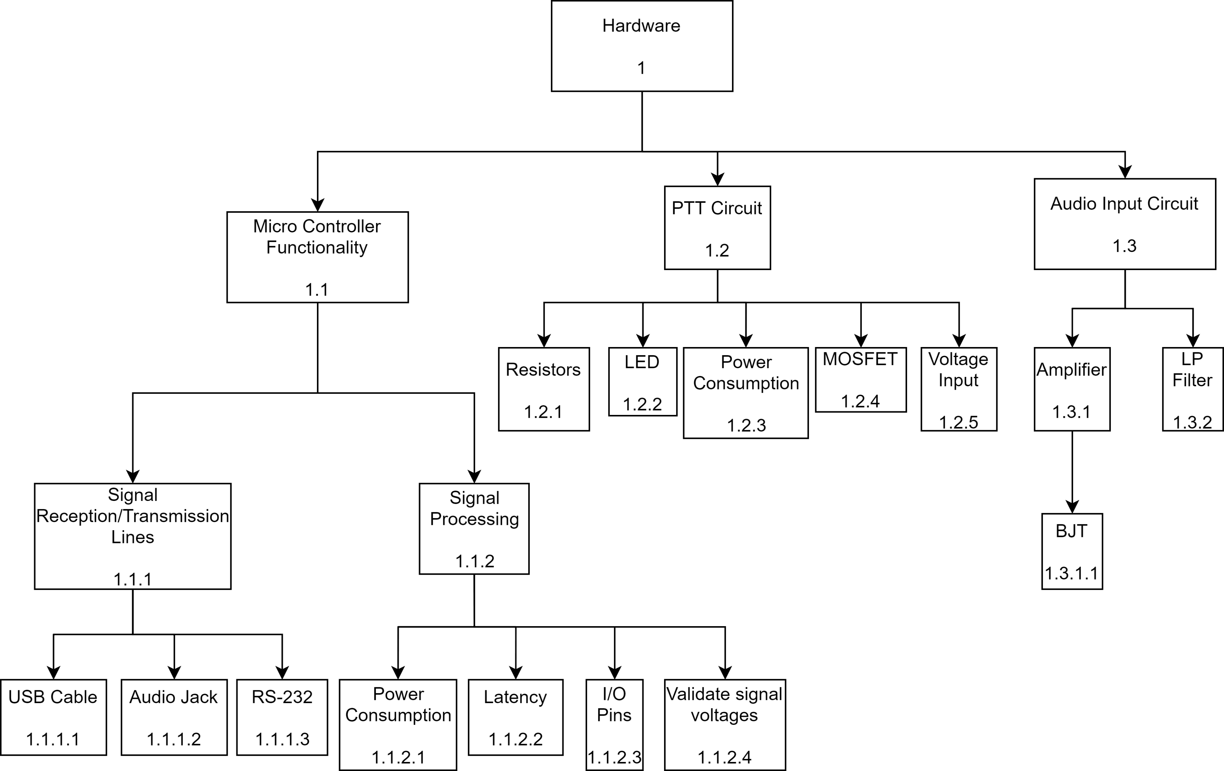
Hardware Testing Tree

Slide 4
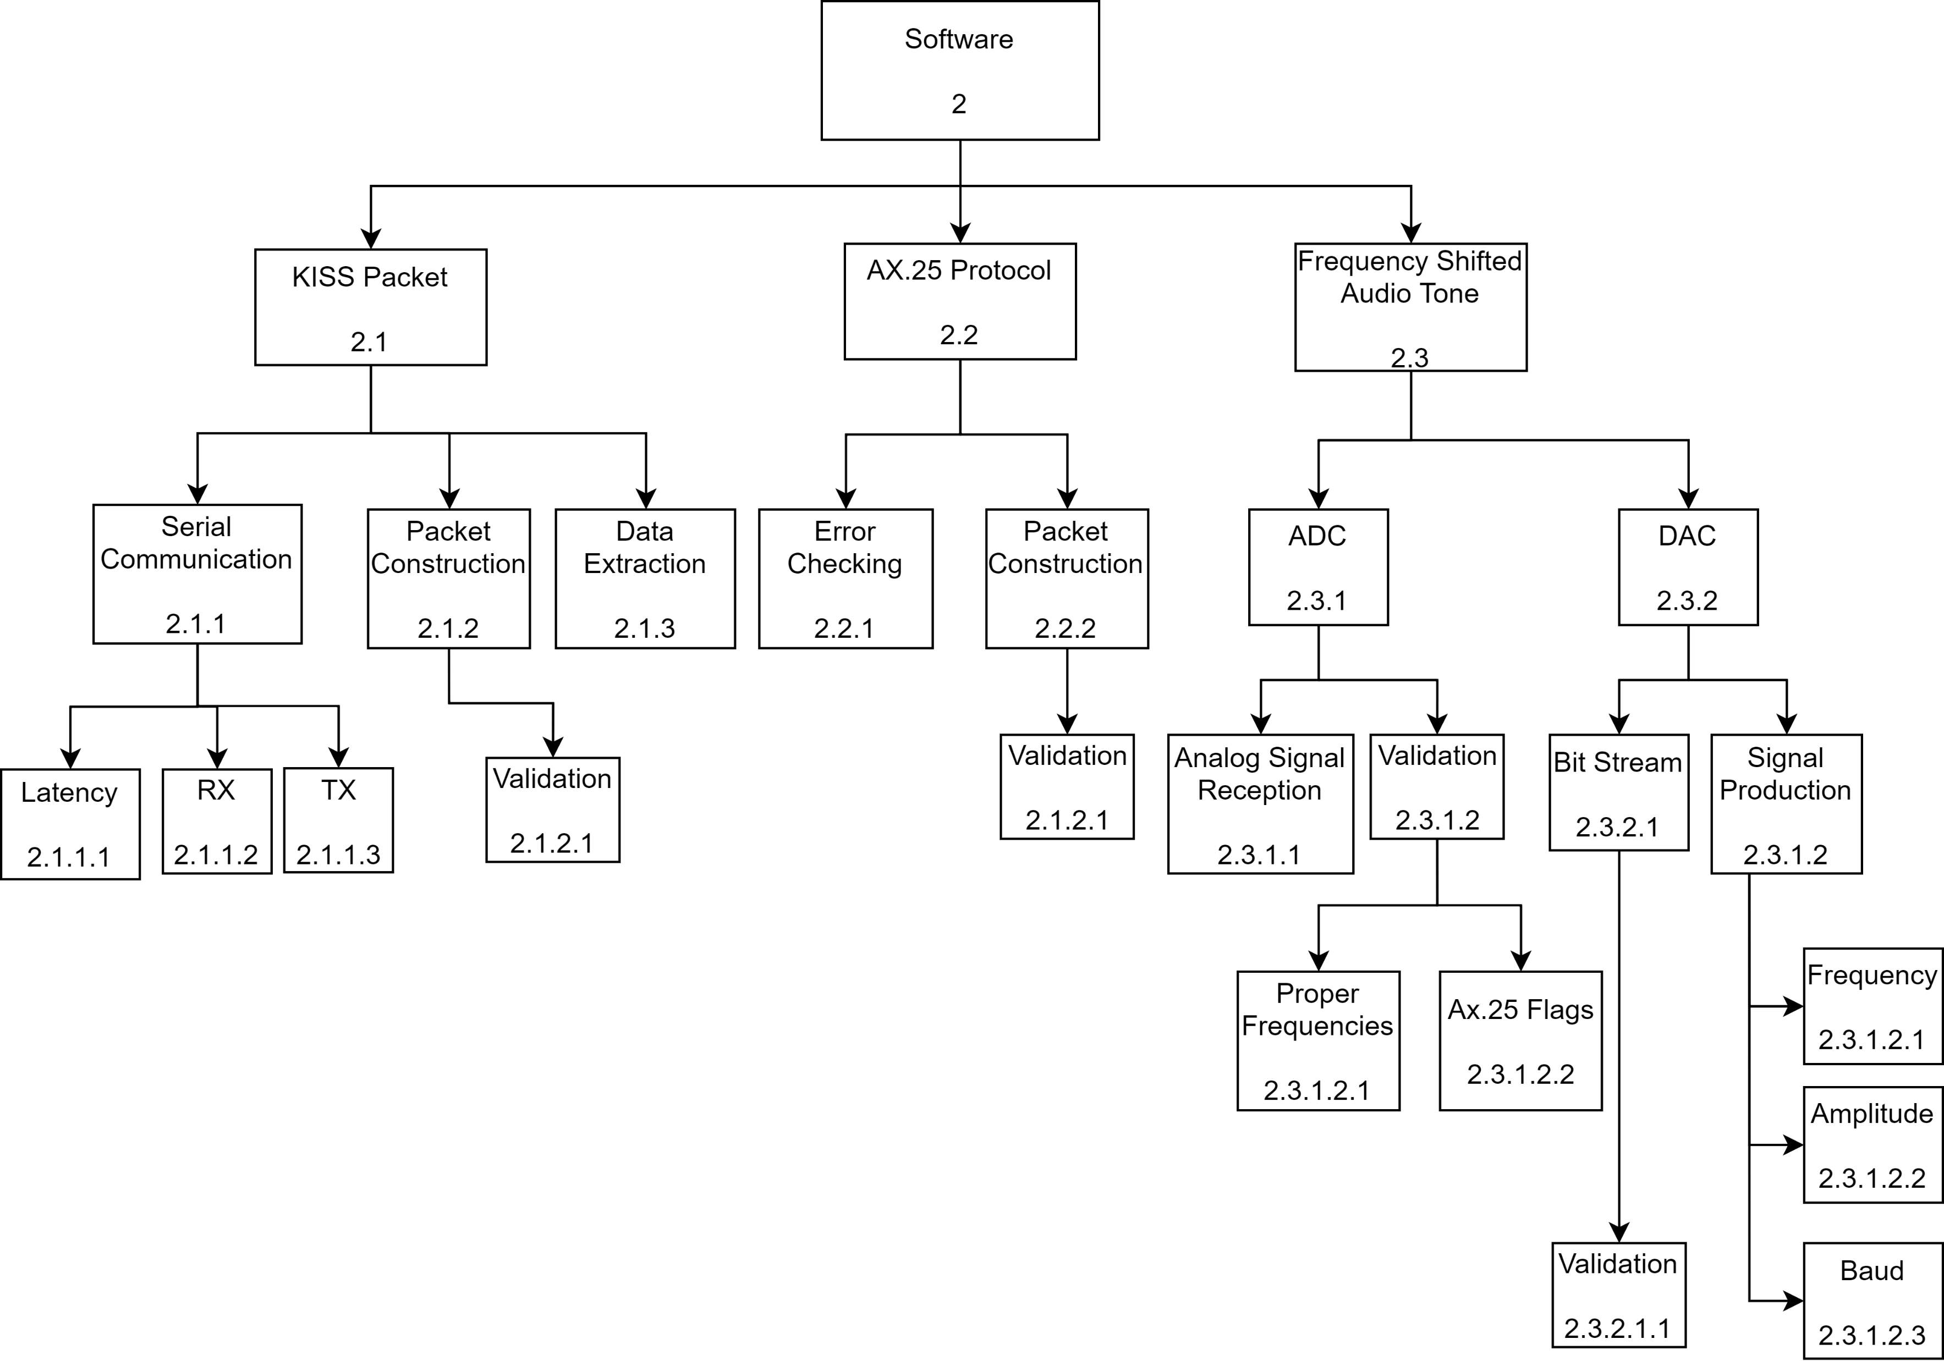
Software Testing Tree

